Slide 1
Crafting a Better Internet Use Policy
Tracy Cook, Montana State Library

Slide 2
Outline
Definition of a policy
4 Tests of Good Policy
Elements of an Internet Use Policy
Issues surrounding Internet Use Polices
  Teens
  Inappropriate usage
  Wi-fi and other devices
E-rate and Children’s Internet Protection Act (CIPA)

Slide 3
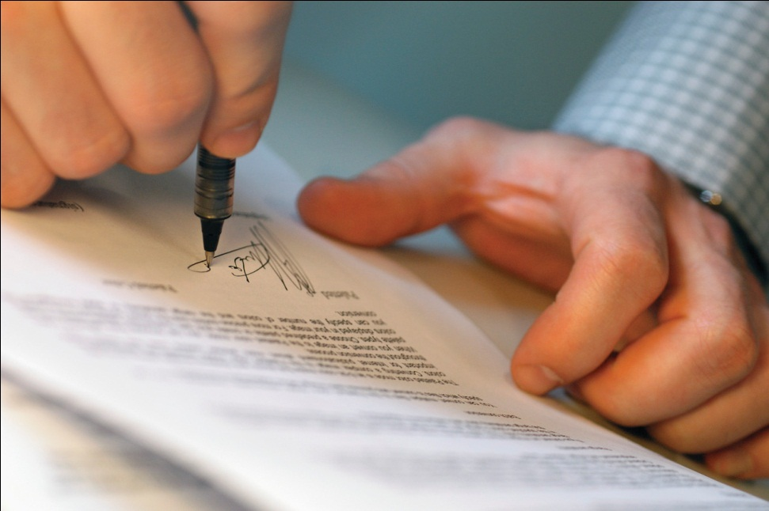
What is a policy?
Balances the needs/wants of users with library resources
Addresses COMMON problems that happen with library resources

Slide 4
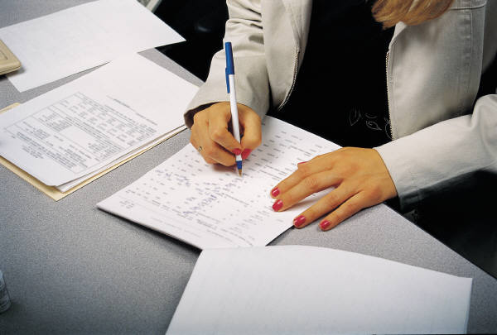
4 Tests of a Good Policy
Does it comply with local, state, and federal law?
Is the language clear and concise?
Does the punishment fit the crime?
Does the policy apply equally to everyone?

Slide 5
What should be included in an Internet Use Policy?
Wi-fi usage
Objectionable viewing; pornography; filtering;
What you are not allowed to download
Security
Deliberate hacking
Reference to Montana Code
Consequences of abuse
Illegal activities – terrorism
Expectations of behavior; how many users per station
Whether or not public library computers can be used to promote private businesses
Voice level if chatting

Slide 6
What to include
Disclaimer/acceptable use clause
  General warning about the internet
  Using this resource in a public place
  MCA 45-8-201: Obscenity Law
Logistics – printing, sign up, limits (or not) on usage
Staff time? Will staff help patrons? How much?
Consequences of violating the policy

Slide 7
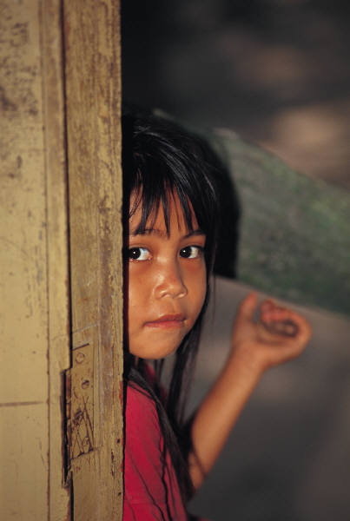
What are the issues?
Teens/minors
Inappropriate usage
Wi-fi and personal devices

Slide 8
Issues for Teens/Minors
Violent games
Gathering in huge groups in computers; compromises privacy of others
Speaker levels for games since we don’t have headphones
Kids as a young as 8 using facebook with their parents’ accounts
Library does not watch over what kids view
How to enforce children under 12 using the Internet
Behaviors escalating when kids are excited

Slide 9
Requirements for Federal Funds
Internet Use Policy needs to address the following:
    Access by minors to inappropriate material on the web
    Safety and security of minors when using email, chat, and other forms of direct electronic communication
    Unauthorized disclosure, use of personal information regarding minors
    Unauthorized access including “hacking” and other unlawful activities by minors online
    Measures designed to restrict minors’ access to materials harmful to minors

Slide 10
Inappropriate Usage Issues

Slide 11
Wi-fi and Devices Issues

Slide 12
Next Steps
Talk about the issues/problems in your library
Encourage healthy debate about the options
Review other libraries’ policies for ideas
Craft a policy that is best for your community and library

Slide 13
Thanks for your time today
Contact Tracy Cook if you have questions
  tcook@mtlib.org
  866-843-6524

